Slide 1
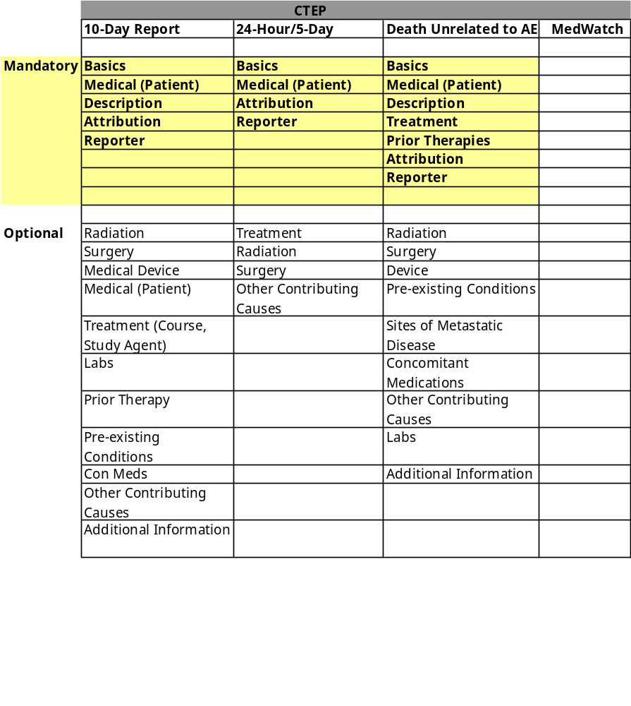
Required/Optional Sections

